Slide 1

EXCEPTIONS
What is an Exception?
● Exceptional event
● Error that occurs during runtime
● Cause normal program flow to be disrupted
● Examples
– Divide by zero errors
– Accessing the elements of an array beyond its range
– Invalid input
– Hard disk crash
– Opening a non
-existent file
– Heap memory exhausted
Java Full Stack Program

Slide 2
Exception Example
1 class DivByZero {
2 public static void main(String args[]) {
3 System.out.println(3/0);
4 System.out.println(“Pls. print me.”);
5 }
6 }

Slide 3
Example: Default Exception Handling
Displays this error message
Exception in thread "main“
java.lang.ArithmeticException: / by zero at
DivByZero.main(DivByZero.java:3)
Default exception handler
Provided by Java runtime
Prints out exception description
Prints the stack trace
-Hierarchy of methods where the exception occurred
Causes the program to terminate

Slide 4
What Happens When an Exception Occurs?
When an exception occurs within a method, the method creates an exception object and hands it off to the runtime system
– Creating an exception object and handing it to the runtime system is called “throwing an exception”
– Exception object contains information about the error, including its type and the state of the program when the error occurred

Slide 5
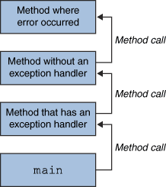
The runtime system searches the call stack for a method that contains an exception handler

Slide 6
When an appropriate handler is found, the runtime system passes the exception to the handler
An exception handler is considered appropriate if the type of the exception object thrown matches the type that can be handled by the handler
The exception handler chosen is said to catch the exception.
If the runtime system exhaustively searches all the methods on the call stack without finding an appropriate exception handler, the runtime system (and, consequently, the program) terminates and uses the default exception handler

Slide 7
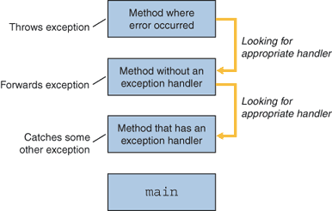
Searching the Call Stack for an Exception Handler

Slide 8
Benefits of Java Exception Handling Framework
Separating Error-Handling code from “regular” business logic code
Propagating errors up the call stack
Grouping and differentiating error types

Slide 9
Separating Error Handling Code from Regular Code
● In traditional programming, error detection, reporting, and handling often lead to confusing spaghetti code
● Consider pseudocode method here that reads an entire file into memory
readFile {
open the file;
determine its size;
allocate that much memory;
read the file into memory;
close the file;
}

Slide 10
Traditional Programming: No separation of error handling code
In traditional programming, To handle such cases, the readFile function must have more code to do error detection, reporting, and handling.
errorCodeType readFile {
initialize errorCode = 0;
open the file;
if (theFileIsOpen) {
determine the length of the file;
if (gotTheFileLength) {
allocate that much memory;
if (gotEnoughMemory) {
read the file into memory;
if (readFailed) {
errorCode = -1;
}
} else {
errorCode = -2;
}

Slide 11
} else {
errorCode = -3; }
close the file;
if (theFileDidntClose && errorCode == 0) {
errorCode = -4;
} else {
errorCode = errorCode and -4;
}
} else {
errorCode = -5;
}
return errorCode;
}

Slide 12
Propagating Errors Up the Call Stack
Suppose that the readFile method is the fourth method in a series of nested method calls made by the main program: method1 calls method2, which calls method3, which finally calls readFile
Suppose also that method1 is the only method interested in the errors that might occur within readFile.
method1 {
call method2;
}
method2 {
call method3;
} method3 {
call readFile;
}

Slide 13
Grouping and Differentiating Error Types
Because all exceptions thrown within a program are objects, the grouping or categorizing of exceptions is a natural outcome of the class hierarchy
An example of a group of related exception classes in the Java platform are those defined in java.io
— IOException and its descendants
– IOException is the most general and represents any type of error that can occur when performing I/O
– Its descendants represent more specific errors. For example, FileNotFoundException means that a file could not be located on disk.

Slide 14
A method can write specific handlers that can handle a very specific exception
The File Not Found Exception class has no descendants, so the following handler can handle only one type of exception.
catch (FileNotFoundException e) {
...
}

Slide 15
A method can catch an exception based on its group or general type by specifying any of the exception's superclasses in the catch statement. For example, to catch all I/O exceptions, regardless of their specific type, an exception handler specifies an IOException argument.
// Catch all I/O exceptions, including
// FileNotFoundException, EOFException, and so on.
catch (IOException e) {
...
}

Slide 16
Checked and Unchecked Exceptions
Checked exception
Java compiler checks if the program either catches or lists the occurring checked exception
If not, compiler error will occur
Unchecked exceptions
Not subject to compile-time checking for exception handling
Built-in unchecked exception classes
Error
Runtime Exception
Their subclasses
Handling all these exceptions may make the program cluttered and may become a nuisance

Slide 17
Creating Your Own Exception Class
Steps to follow
– Create a class that extends the RuntimeException or the Exception class
– Customize the class
Members and constructors may be added to the class
Example:
1 class HateStringExp extends RuntimeException {
2 /* some code */
3 }

Slide 18
How To Use Your Own Exceptions
1 class TestHateString {
2 public static void main(String args[]) {
3 String input = "invalid input";
4 try {
5 if (input.equals("invalid input")) {
6 throw new HateStringExp();
7 }
8 System.out.println("Accept string.");
9 } catch (HateStringExp e) {
10 System.out.println("Hate string!”);
11 }
12 }
13 }

Slide 19
Java Threads
What is a thread ?
A sequential (or single-threaded) program is one that, when executed, has only one single flow of control.
i.e., at any time instant, there is at most only one instruction (or statement or execution point) that is being executed in the program.
A multi-threaded program is one that can have multiple flows of control when executed.
At some time instance, there may exist multiple instructions or execution points) that are being executed in the program
Ex: in a Web browser we may do the following tasks at the same time:
1. scroll a page,
2. download an applet or image,
3. play sound,
4 print a page.
A thread is a single sequential flow of control within a program.

Slide 20
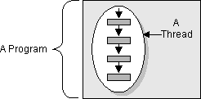
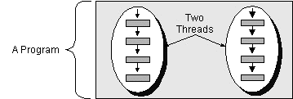
Single-threaded vs Multithreaded programs
{ A();
newThreads {
{ A1(); A2(); A3() };
{B1(); B2() }
}
}
{ A(); A1(); A2(); A3();
B1(); B2(); }

Slide 21
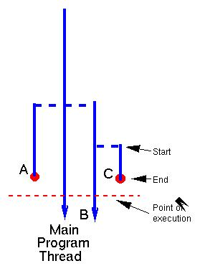
Thread ecology in a java program
started by java from main(String[])
started by main thread
started by B thread
lifetime of C thread

Slide 22
Define and launch a java thread
Each Java Run time thread is encapsulated in a java.lang.Thread instance.
Two ways to define a thread:
1. Extend the Thread class
2. Implement the Runnable interface :
package java.lang;
public interface Runnable { public void run() ; }
Steps for extending the Thread class:
Subclass the Thread class;
Override the default Thread method run(), which is the entry point of the thread, like the main(String[]) method in a java program.

Slide 23
Define a Thread
// Example:
public class Print2Console extends Thread {
public void run() { // run() is to a thread what main() is to a java program
for (int b = -128; b < 128; b++) out.println(b); }
… // additional methods, fields …
}
Implement the Runnable interface if you need a parent class:
// by extending JTextArea we can reuse all existing code of JTextArea
public class Print2GUI extend JTextArea implement Runnable {
public void run() {
for (int b = -128; b < 128; b++) append( Integer.toString(b) + “\n” ); }
}

Slide 24
How to launch a thread
create an instance of [ a subclass of ] of Thread, say thread.
Thread thread = new Print2Console();
Thread thread = new Thread( new Print2GUI( .. ) );
2. call its start() method, thread.start();. // note: not call run() !!
Ex:
Printer2Console t1 = new Print2Console(); // t1 is a thread instance !
t1.start() ; // this will start a new thread, which begins its execution by calling t1.run()
… // parent thread continue immediately here without waiting for the child thread to complete its execution. cf: t1.run();
Print2GUI jtext = new Print2GUI();
Thread t2 = new Thread( jtext);
t2.start();
…

Slide 25
The java.lang.Thread constructors
// Public Constructors
Thread([ ThreadGroup group,] [ Runnable target, ]
[ String name ] );
Instances :
Thread();
Thread(Runnable target);
Thread(Runnable target, String name);
Thread(String name);
Thread(ThreadGroup group, Runnable target);
Thread(ThreadGroup group, Runnable target, String name);
Thread(ThreadGroup group, String name);
// name is a string used to identify the thread instance
// group is the thread group to which this thred belongs.

Slide 26
Some thread property access methods
int getID() // every thread has a unique ID, since jdk1.5
String getName(); setName(String)
// get/set the name of the thread
ThreadGroup getThreadGroup();
int getPriority() ; setPriority(int) // thread has priority in [0, 31]
Thread.State getState() // return current state of this thread
boolean isAlive()
Tests if this thread has been started and has not yet died. .
boolean isDaemon()
Tests if this thread is a daemon thread.
boolean isInterrupted()
Tests whether this thread has been interrupted.

Slide 27
State methods for current thread accesses
static Thread currentThread()
Returns a reference to the currently executing thread object.
static boolean holdsLock(Object obj)
Returns true if and only if the current thread holds the monitor lock on the specified object.
static boolean interrupted()
Tests whether the current thread has been interrupted.
static void sleep( [ long millis [, int nanos ]] )
Causes the currently executing thread to sleep (cease execution) for the specified time.
static void yield()
Causes the currently executing thread object to temporarily pause and allow other threads to execute.

Slide 28
An example
public class SimpleThread extends Thread {
public SimpleThread(String str) { super(str); }
public void run() {
for (int i = 0; i < 10; i++) {
System.out.println(i + " " + getName());
try { // at this point, current thread is ‘this’.
Thread.sleep((long)(Math.random() * 1000));
} catch (InterruptedException e) {}
}
System.out.println("DONE! " + getName());
} }

Slide 29
Thank You

